Slide 1
Chapter 4: Mendelian genetics

Slide 2
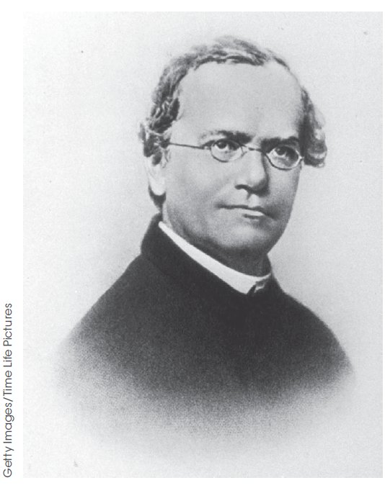
Inheritance
Inheritance patterns are the ways in which genes are passed from one generation to another.
This is also referred to as heredity.
Gregor Mendel in the 19th century
pioneered the study of inheritance.
Figure 4.1

Slide 3
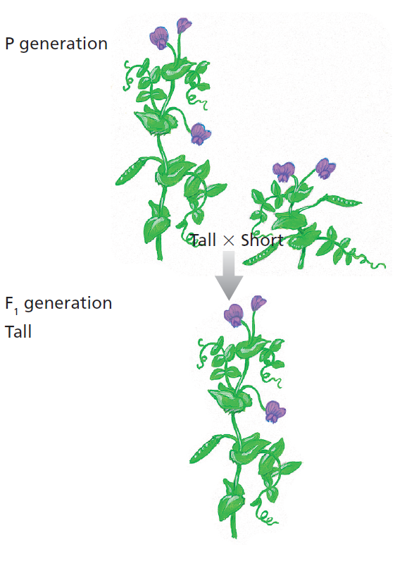
Mendelian genetics
Studies on peas
Mendel took pure-breeding tall plants and pollinated them with pure-breeding short plants. These plants are the parental generation (P).
He observed that all of the first filial generation (F₁) offspring were tall.
When he intercrossed the F₁ plants, the second filial generation (F₂) offspring contained a mix of tall and short plants. Three quarters were tall and one quarter was short.
Figure 4.4

Slide 4
Mendelian genetics
Genes and traits
The gene for height in pea plants is controlled by a single gene.
Since there are two homologous chromosomes, an individual has two alleles of each gene. These can be the same or different.
The possible alleles for the height gene are T and t.

Slide 5
Mendelian genetics
Genes and traits
The T allele causes plants to be tall and the t allele causes plants to be short.
The T allele is dominant to the t allele. Having a single copy of T
causes plants to be tall regardless of whether they also have the t allele
(i.e. TT or Tt).
The t allele is recessive to the T allele. Only individuals with the tt genotype will have the short phenotype.
This is an example of autosomal dominance, since the gene is on an autosome (i.e. not a sex chromosome) and the pattern of inheritance of the trait is dominant or recessive.

Slide 6
Mendelian genetics
Genes and traits
Individuals with two copies of an allele are homozygous for the allele;
e.g. TT or tt.
Individuals with two different alleles have a heterozygous genotype;
e.g. Tt.

Slide 7
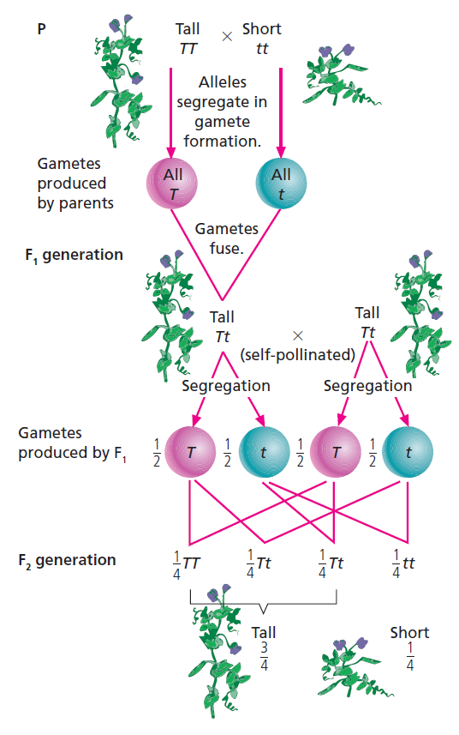
Probabilities of inheritance
Mendelian genetics
Random assortment, or segregation, of chromosomes during meiosis means gametes have a ½ chance, or 50% probability, of inheriting each allele of a gene from each parent.
When these probabilities are multiplied, the probability of each genotype in the offspring is ¼.
The probability of the tall phenotype is ¾ and the probability of the short phenotype is ¼.
Figure 4.5

Slide 8
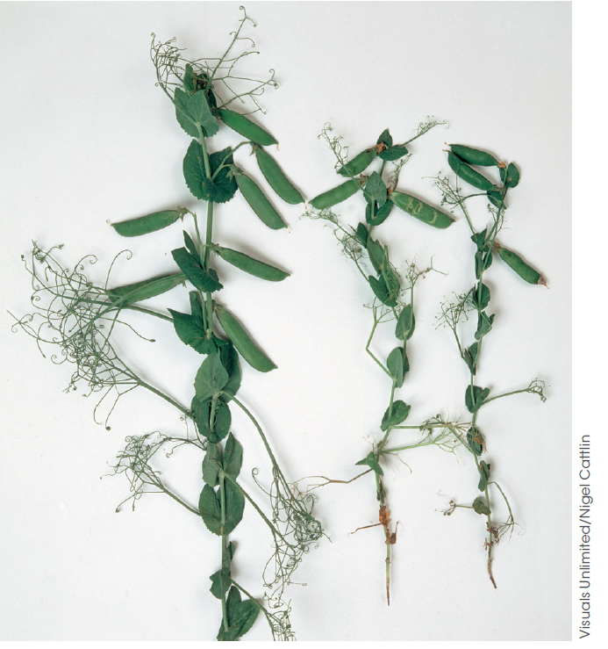
Summary: autosomal dominance
Mendelian genetics
Tall phenotype
Genotypes TT or Tt
75% of offspring
Short phenotype
Genotype tt
25% of offspring
Figure 4.3

Slide 9
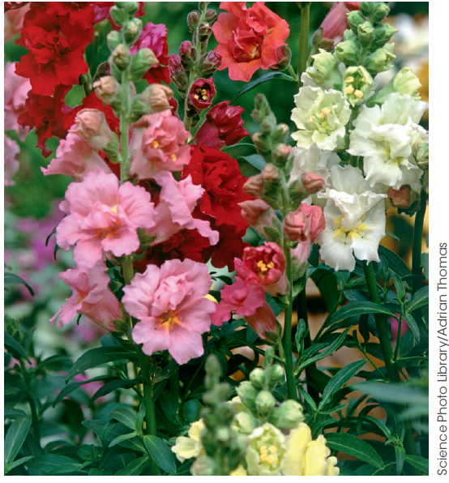
Incomplete dominance
Mendelian Genetics
In this image, the white petal phenotype (C^{W} allele) and red phenotype (C^{R}) combine to make pink petals.
This trait shows incomplete or partial dominance.
Both alleles contribute to the phenotype and neither is fully dominant.
Crossing pink snapdragons will give what proportions of white, red and pink offspring?
Figure 4.6

Slide 10
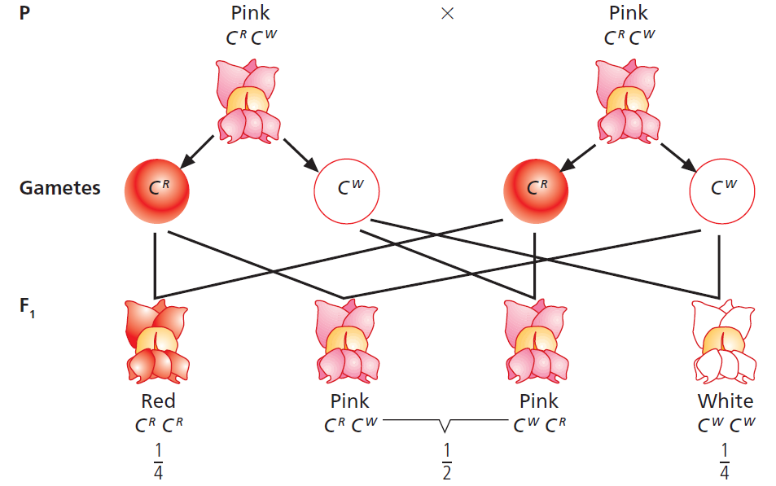
Incomplete dominance
Mendelian genetics
Figure 4.7

Slide 11
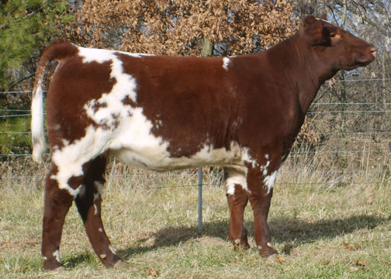
Codominance
Mendelian genetics
In roan cattle, the alleles for white and red hair are both expressed
– some hairs are white and some are red.
These alleles are codominant.
from diamondmshorthorns.com

Slide 12
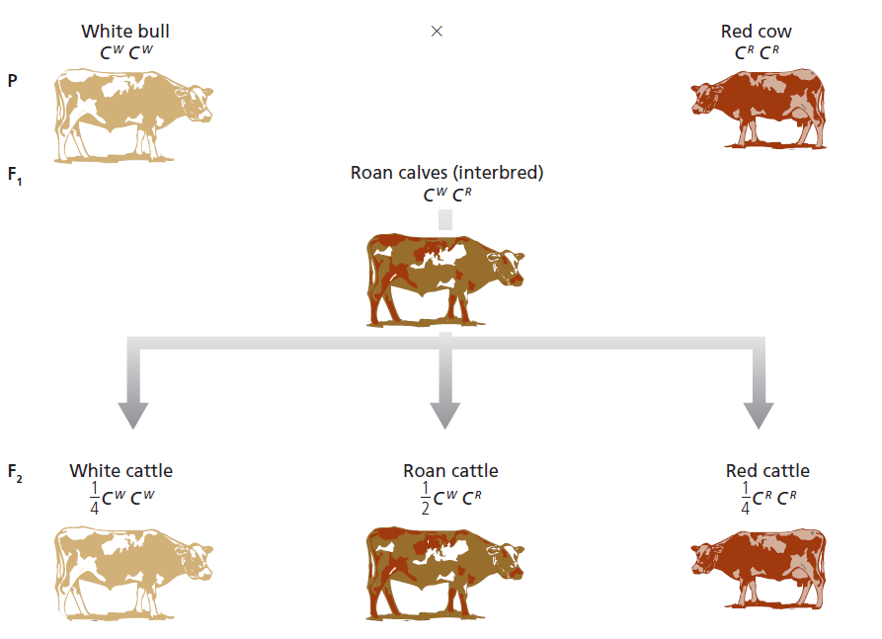
Codominance
Mendelian genetics
A cross of roan cattle will produce white (¼) red (¼) and roan (½) calves.
Figure 4.8

Slide 13
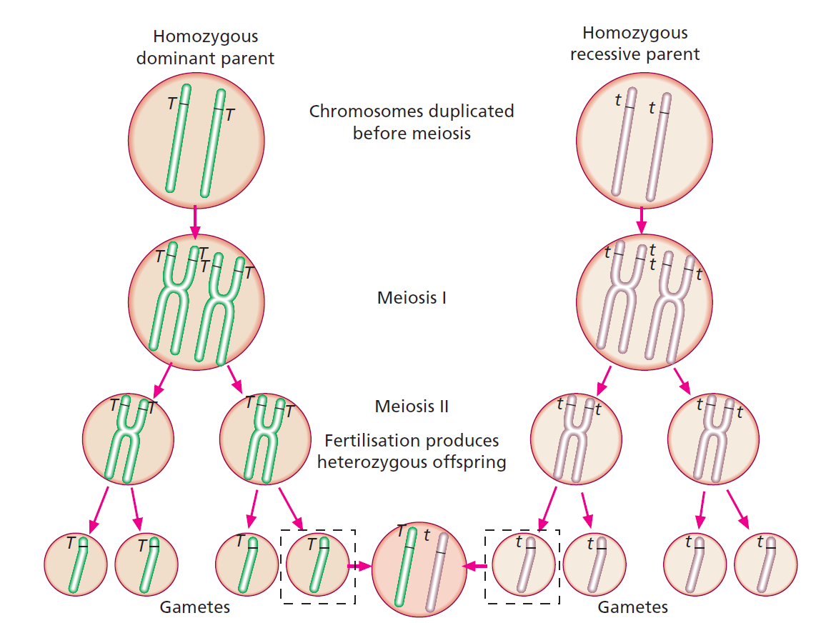
Incorporating our knowledge of meiosis into genetics
Mendelian genetics
Monohybrid cross – studying the inheritance of a single gene
In this case, the F1 offspring can only have one possible genotype.
How would the gametes differ if the parent expressing the dominant trait (on the left) was heterozygous?
Figure 4.11

Slide 14
Punnett square
Mendelian genetics
A useful way to represent possible genotypes of offspring based on the
possible gametes.
Parent A’s possible gametes
Possible combinations of alleles in the offspring
Parent B’s
possible gametes

Slide 15
Punnett square
Mendelian genetics
E.g. A cross between a tall (TT) and a short (tt) pea plant.
First, assign the parents to each side of the square and note down their possible gametes
Tall plant’s possible gametes
Next, fill in the square with the possible combinations of gametes in the offspring
T
T
Possible combinations of alleles in the offspring
t
Tt
Tt
Short plant’s
possible gametes
t
Tt
Tt
Probabilities of genotypes of the offspring can be determined using the square. In this case, 4/4 offspring are predicted to be heterozygous.

Slide 16
Punnett square
Mendelian genetics
Now try filling in the square for a cross between a heterozygous tall and a short pea plant.
Tall plant’s possible gametes
Short plant’s
possible gametes

Slide 17
Punnett square
Mendelian Genetics
Now try filling in the square for a cross between a heterozygous tall and a short pea plant.
Tall plant’s possible gametes
T
t
Half the offspring are predicted to be tall (2/4)
and half are predicted to be short (2/4)
t
Tt
tt
Short plant’s
possible gametes
t
Tt
tt

Slide 18
Punnett square
Mendelian genetics
This time try creating a Punnett square for a cross with two heterozygous tall plants.
Plant A’s possible gametes
The predicted offspring ratio is 3:1 (tall : short)
75% of the offspring are predicted to be tall (3/4)
and 25% are predicted to be short (1/4)
T
t
T
TT
Tt
Plant B’s
possible gametes
t
Tt
tt

Slide 19
Punnett square
Mendelian genetics
What if we don’t know the parent’s genotype? We can conduct a test cross.
Tall parent with unknown genotype
T
?
If all offspring are tall, the parent’s genotype must be TT.
If approximately half of the offspring are short, the parent’s genotype must be Tt.
t
Tt
Tt
Homozygous
recessive parent
Tt
tt
t
Tt
Tt
Why is this genotype used in a test cross?
Tt
tt

Slide 20
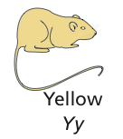





Embryonic lethality
Mendelian genetics
Sometimes a combination of alleles produces a lethal phenotype.
This changes the observed ratios of phenotypes in the offspring.
E.g. mice that are homozygous YY for yellow fur colour die before birth.
The expected ratio of 1:2:1 is not observed.

Slide 21
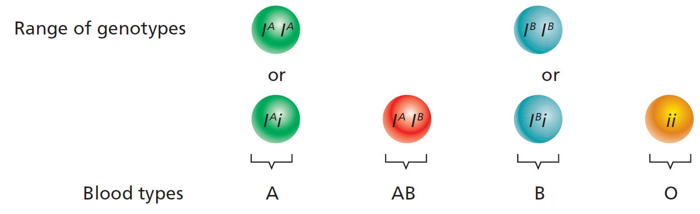
Combinations of modes of inheritance
The genes encoding a person’s blood type show codominance and dominance.
They are still inherited in a Mendelian way.
Figure 4.17
If a person’s blood group is A and their mother’s blood group is B, what are the possible blood groups of their father?

Slide 22
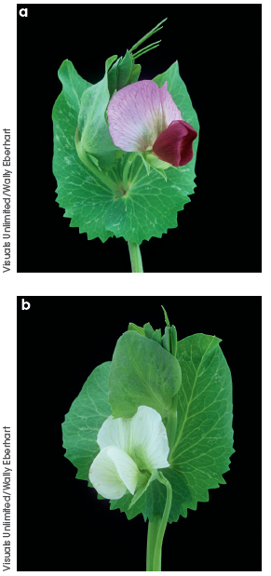
Dihybrid inheritance
To study the inheritance of alleles of two genes, we can conduct a dihybrid cross.
Pea plants can have purple or white flowers.
When he crossed a tall purple pea with a short white pea plant, Mendel observed offspring plants in the following ratio:
9 : 3 : 3 : 1
Tall purple : short purple : tall white : short white
This can be explained if the purple phenotype is dominant over the white phenotype.
Figure 4.18

Slide 23
A Punnett square of a dihybrid cross with homozygous parents
Mendelian genetics
Tall purple parent TTPP
TP
TP
TP
TP
tp
TtPp
TtPp
TtPp
TtPp
Short white parent ttpp
tp
TtPp
TtPp
TtPp
TtPp
tp
TtPp
TtPp
TtPp
TtPp
tp
TtPp
TtPp
TtPp
TtPp

Slide 24

A Punnett square of a dihybrid cross with heterozygous parents
Mendelian genetics
Tall purple 9/16
Tall white 3/16
Short purple 3/16
Short white 1/16
Tall purple parent TtPp
TP
Tp
tP
tp
TP
TTPP
TTPp
TtPP
TtPp
Tall white parent TtPp
Tp
TTPp
TTpp
TtPp
Ttpp
tP
TtPP
TtPp
ttPP
ttPp
tp
TtPp
Ttpp
ttPp
ttpp

Slide 25
A test cross for a dihybrid trait
Mendelian genetics
Tall purple parent
TTPP
TtPp
TP
TP
TP
Tp
TP
tP
TP
tp
Short white parent plant ttpp
tp
TtPp
TtPp
TtPp
Ttpp
TtPp
ttPp
TtPp
ttpp

Slide 26
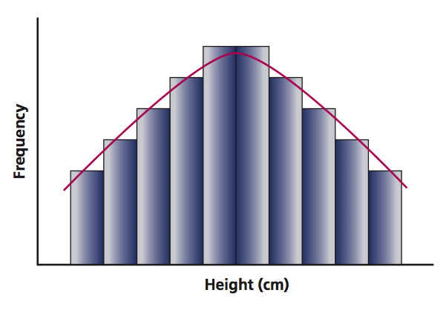
Polygenic inheritance
Traits, such as height in humans, are controlled by multiple genes and are therefore polygenic traits.
Polygenic traits often show continuous variation.
(Flower colour in peas is a discontinuous trait.)

Slide 27
Sex-linked inheritance
Genes on the sex chromosomes (the X or Y chromosomes) are sex-linked.
If one allele is present and the other is absent, such as genes on the X chromosome in males, the person is neither homozygous nor heterozygous. Instead, they are said to be hemizygous.
Sex-linked genes are inherited differently between males and females.
X-linked recessive genes are found on the X chromosome. These are always expressed in males. A female can be a carrier but not express the trait.

Slide 28
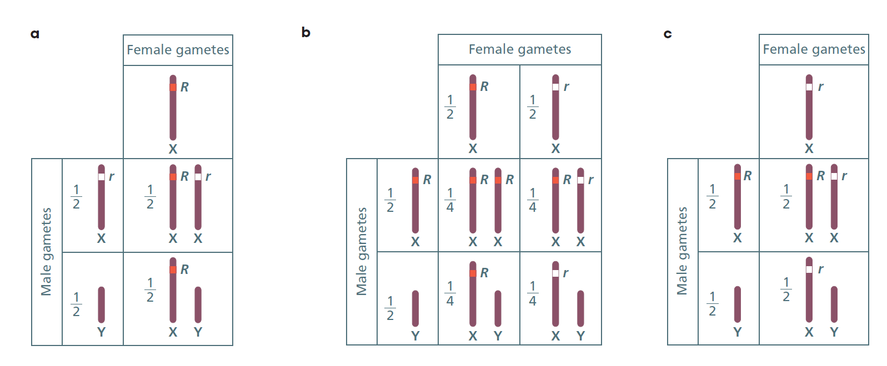
Sex-linked inheritance
In this example of eye colour in fruit flies, red (R) is dominant over white (r).
Female with RR genotype
Female with Rr genotype
Female with rr genotype
Figure 4.26
Notice that the genotypes are sex-linked.

Slide 29
Sex-linked inheritance
Traits can also be X-linked dominant
a male with the trait will pass it on to all his daughters.
or Y-linked
an obvious example is the male gender.

